Slide 1
Chapter 7 Pass and Return Arrays

Slide 2
Today
Check In
Quiz Module 03 March 19/20. Print technical documentation for quiz of your own work.
Goals
Copying Elements of one Array to another array
Passing Arrays to Method (pass by reference)
Returning Arrays from Method
Opportunity: Open-source initiative at the Cybersecurity Center to design and maintain SIEM software for Centurion Secured. If you are interested complete this form.
Set Up Class Code Exploration for today:
Download and Import TestPassArrays.java

Slide 3
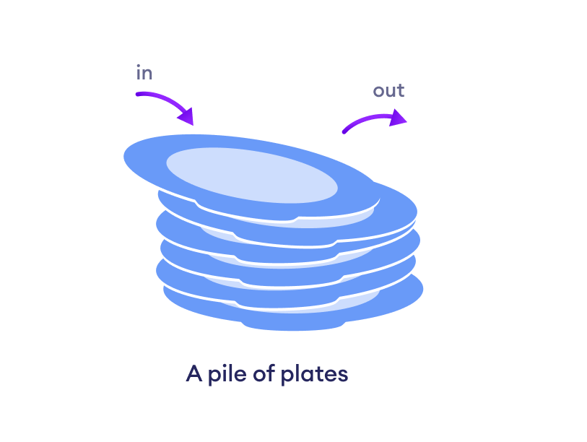

Review
public static void main(String[] args) {
int number1 = 7;
int number2 = 82;
swap(number1, number2);
} // main
public static void swap (int num1, int num2) {
int temp = num1;
num1 = num2;
num2 = temp;
} // end swap
public static void main(String[] args) {
final int TOTAL_NUMBERS = 5;
int[] numbers = new int[TOTAL_NUMBERS];
passArray(numbers);
} // main
public static void passArray(int passedArray[])
{
Draw a picture showing stack memory and how primitive data types are passed from one method to another.
How are arrays stored in memory? What is stored on the stack and what is stored on the heap?
What do you think is passed to a method when passing an array?

Slide 4
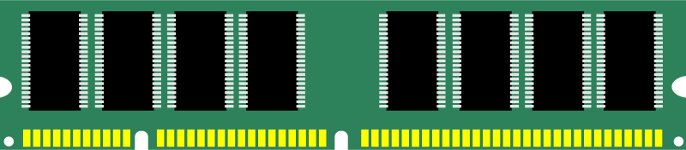
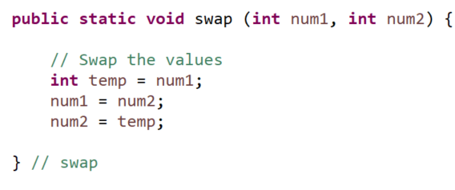
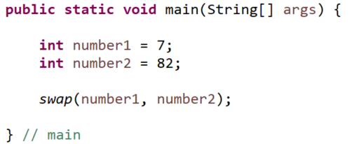

Methods, Stacks and Memory
Main method called first and stack created in memory for declared variables in main method.
Then swap invoked (called) and another stack of memory for declared variables in swap method
These variables are in a separate stack of memory and once the method exits the memory is deallocated (deleted)
0x7fff6771c324
0x7fff6771c456
0x7fff677af799
Memory allocated with main stack
0x7fff6771h587
0x7fff6771g123

Slide 5
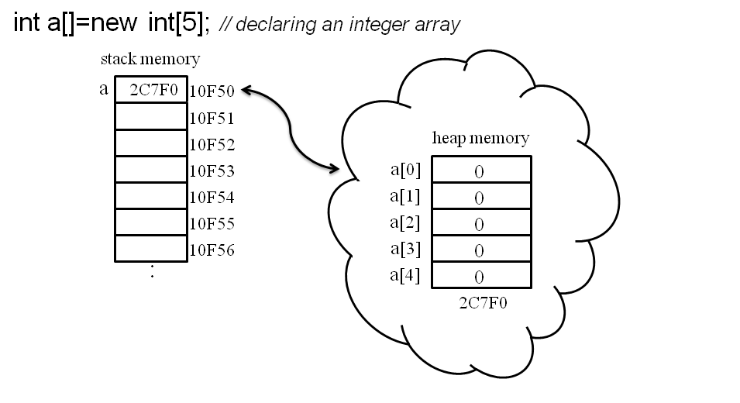
Methods and Arrays
Declaring arrays works differently then primitive data types.
Int a[] means declare enough memory on the stack to hold an address.
New int[5] means declare enough memory on the heap to store 5 integers consecutively in memory
New int[5] returns the address on the heap where index[0] is located and assigns it to the a identifier

Slide 6
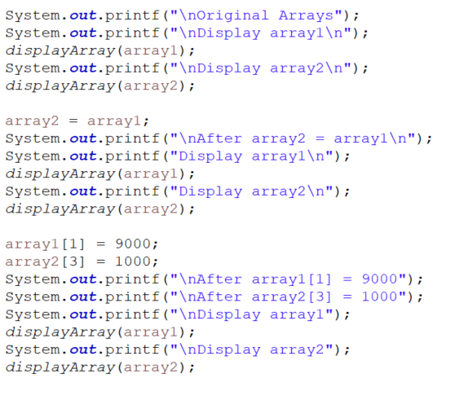
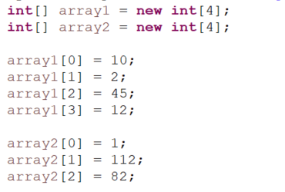
Part 1: Assign Array to Another Array
Debug and on paper answer questions part 1 code.

Slide 7


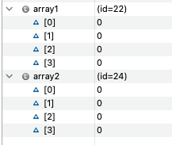
Assigning Arrays
With primitive types, assigning value of one variable to another works different than assigning one reference variable to another.
0x7fff6771h587
10
0x7fff6771g123
10
Reference variable stores heap address on the stack
Array values stored in consecutive memory on the heap
Heap memory array1
Id22 memory address
Heap Id22
memory address
Heap memory array2
Heap Id24
memory address

Slide 8

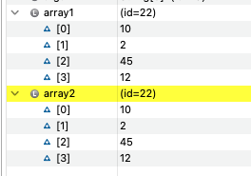
Assigning Arrays
With primitive types, assigning value of one variable to another works different than assigning one reference variable to another.
Heap memory array1
array1 still references address for id 22
Heap Id22
memory address
array2 now references array1’s memory address for id 22
Heap memory array2
Uh oh! How do I found the address on the heap for array2?
Heap Id24
memory address

Slide 9

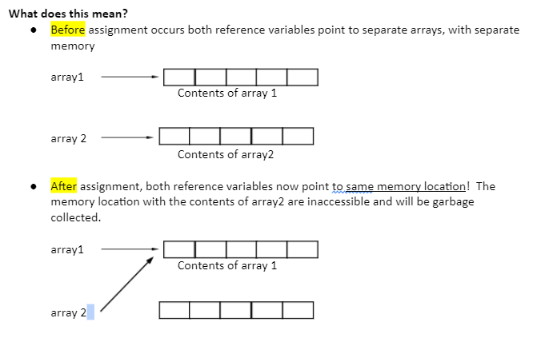
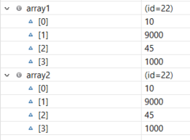
Array Assignment
This assigns the reference memory address on the heap for array1 to array2.
Now both array reference variables hold the same address to the heap memory at id =22.
You no longer have a reference variable on the stack to find the other array contents to the heap memory at id 24.

Slide 10
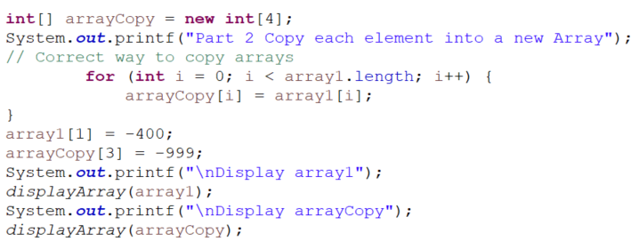
Part 2: Copy Array into New Array
Debug and discuss.

Slide 11


Copy Arrays
Here is some approaches that DO work, there are 3 with the 1st being what you typically see in code:
Use a loop to copy individual elements one by one. This what we will use for now.
Use the static arraycopy method in the System class - we will learn in next lecture

Slide 12
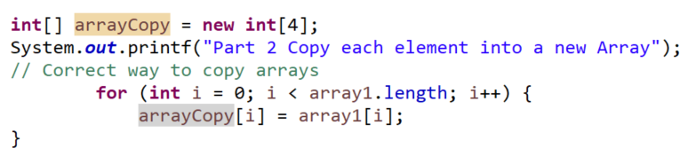


Copy Each Element to New Array Address
Copy contents of array into new array using a for loop copy each element of array1 to arrayCopy
Notice each array has a different id so a different location in memory.
Heap Id22
array1 Memory allocated
Assign
Assign
Assign
arrayCopy Memory location
0x7fff6771c324
Heap Id27
Assign

Slide 13

Passing Primitive Data Types
Remember:
When passing primitive data types from one method to another we are passing-by-value
0x7fff6771c324
copy
copy
0x7fff6771c456
0x7fff6771c456
0x7fff6771ce567
Pass by value means a copy of the value from one memory location is put in another memory location. Even if you would make the formal parameter names the same they are still located in two different memory locations.

Slide 14
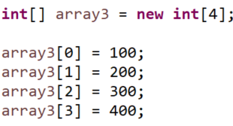

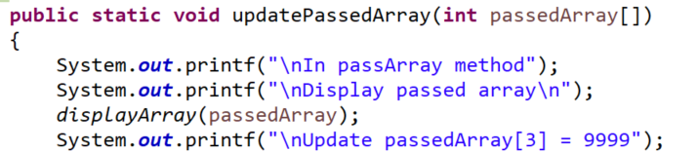
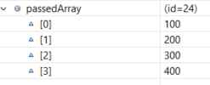
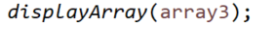
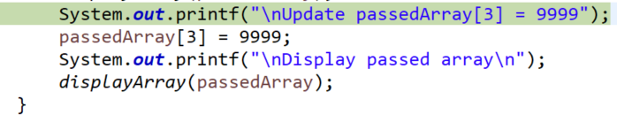


Passing Arrays to Methods
Main Method Stack
Passing an array it passes by reference. Meaning array3 reference variable holding memory location id24 is passed. The passedArray now has a copy of address id24 and will refer to the same memory id24 on the heap. Any update to array in method will update that memory location on the heap.
In method
After passedArray[3] = 9999;
Back in main
Same heap being updated at id24

Slide 15
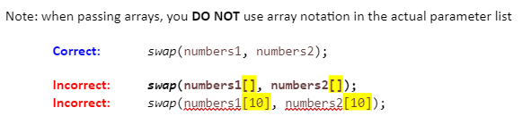
Passing Arrays By Reference
Pass by reference means a memory address which defines where the value is stored on the heap is passed.
a reference to the heap memory of the array where array starts at [0] is sent to the method
the method now has the address of the array so any changes it makes to the array contents are occurring to the “actual” array, not to a copy of the array.
The original array outside the method is affected by changes inside the method because both are referencing the same heap memory address

Slide 16
Passing by Reference and by Value
Pass by reference means a memory address is passed which defines where in memory information is stored.
Pass by value means a copy of the actual value is passed on.
copy
copy
Pass copy of address that reference memory on the heap
Both array3 and passedArray reference same memory location so any updates to array are to same array.
0x7fff6771c324
Heap id24
0x7fff6771c456
0x7fff6771c324
0x7fff6771c324

Slide 17
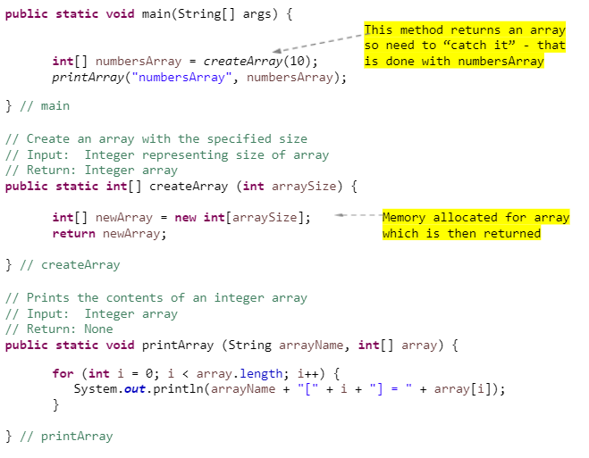
Returning Arrays from a Method
You learned how to return primitive data types from methods. You can also return reference variables hold array address on the heap from a methods.
The MEMORY allocation for the array is done within the method!
When control returns to the main, numbersArray it returns the id of the memory on the heap where the array is stored
Assigns address where array is located on the heap.
Returns address where array is located on the heap

Slide 18
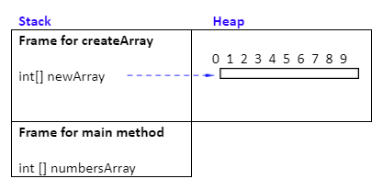
Create Array Method Running
Main calls createArray - a frame for createArray method is pushed onto stack
Memory is allocated on the heap for newArray inside createArray method
newArray is a reference to that memory
newArray reference is returned from the method, that is, an address to array is returned

Slide 19
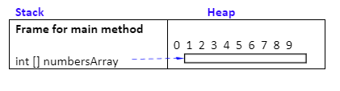
Create Array Method Completes
Stack frame for createArray is popped off the stack
newArray variable holding address no longer exists on the createArray stack
But the memory on the heap it was pointing to is now pointed to by numbersArray

Slide 20
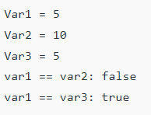
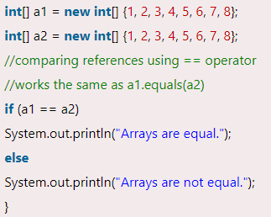
Comparison Operator
Comparing Primitive data type variables
The comparison operator == is used to check whether the two given operands are equal or not. The operator returns true if the operand at the left-hand side is equal to the right-hand side, else false.
What about comparing two reference variables?
How to Compare Two Arrays in Java - Javatpoint
In the example a1 and a2 are the two references of two different memory addresses of where array was created on the heap.
Comparing Non Primitive data type reference variables

Slide 21
Preparation
GE03 Loops, Methods and Software Development and GE03 Review -
Create a new class called M04PassArrays
Create an array in main called numbersArray and an int called number
Create method: public static void updateRandomValue(int passedArray[], int passedNumber)
Pass the numbersArray and number to the updateRandomValue method
Update the passedNumber in the method to a random number between 1 and 10
Update the all the values in the array to random value between 1 and 10
After the method is called in main
Display the number that was passed
Call a display method from main to print the values in the array
Go to canvas to answer today’s lecture participation and upload what you completed.
Review GE04 Technical Documentation

